Slide 1


Lightning Talk: Spotify
HOME
TABLE OF CONTENTS
PLAYLIST
01
Organization
02
Spotify Wrapped
03
Types of Metadata
04
AI DJ
Trisha Faust
INFO 590 Dr. Willever-Farr

Slide 2
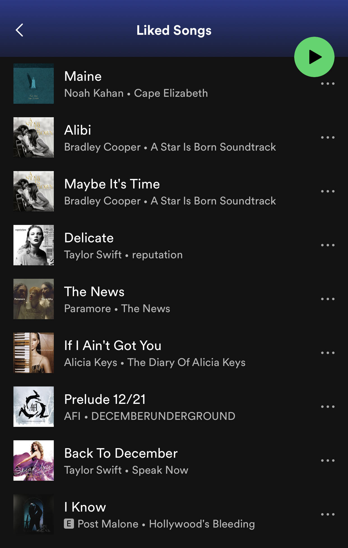
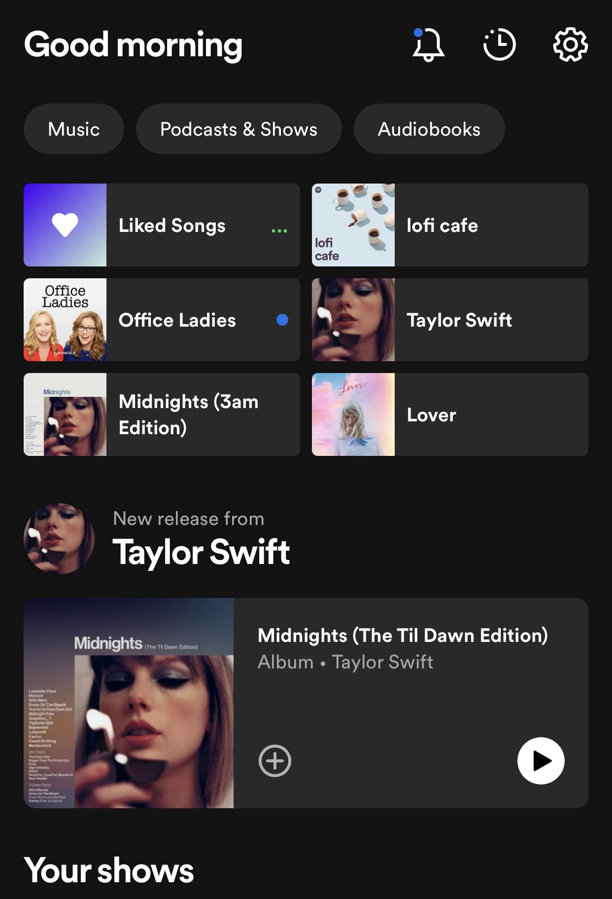
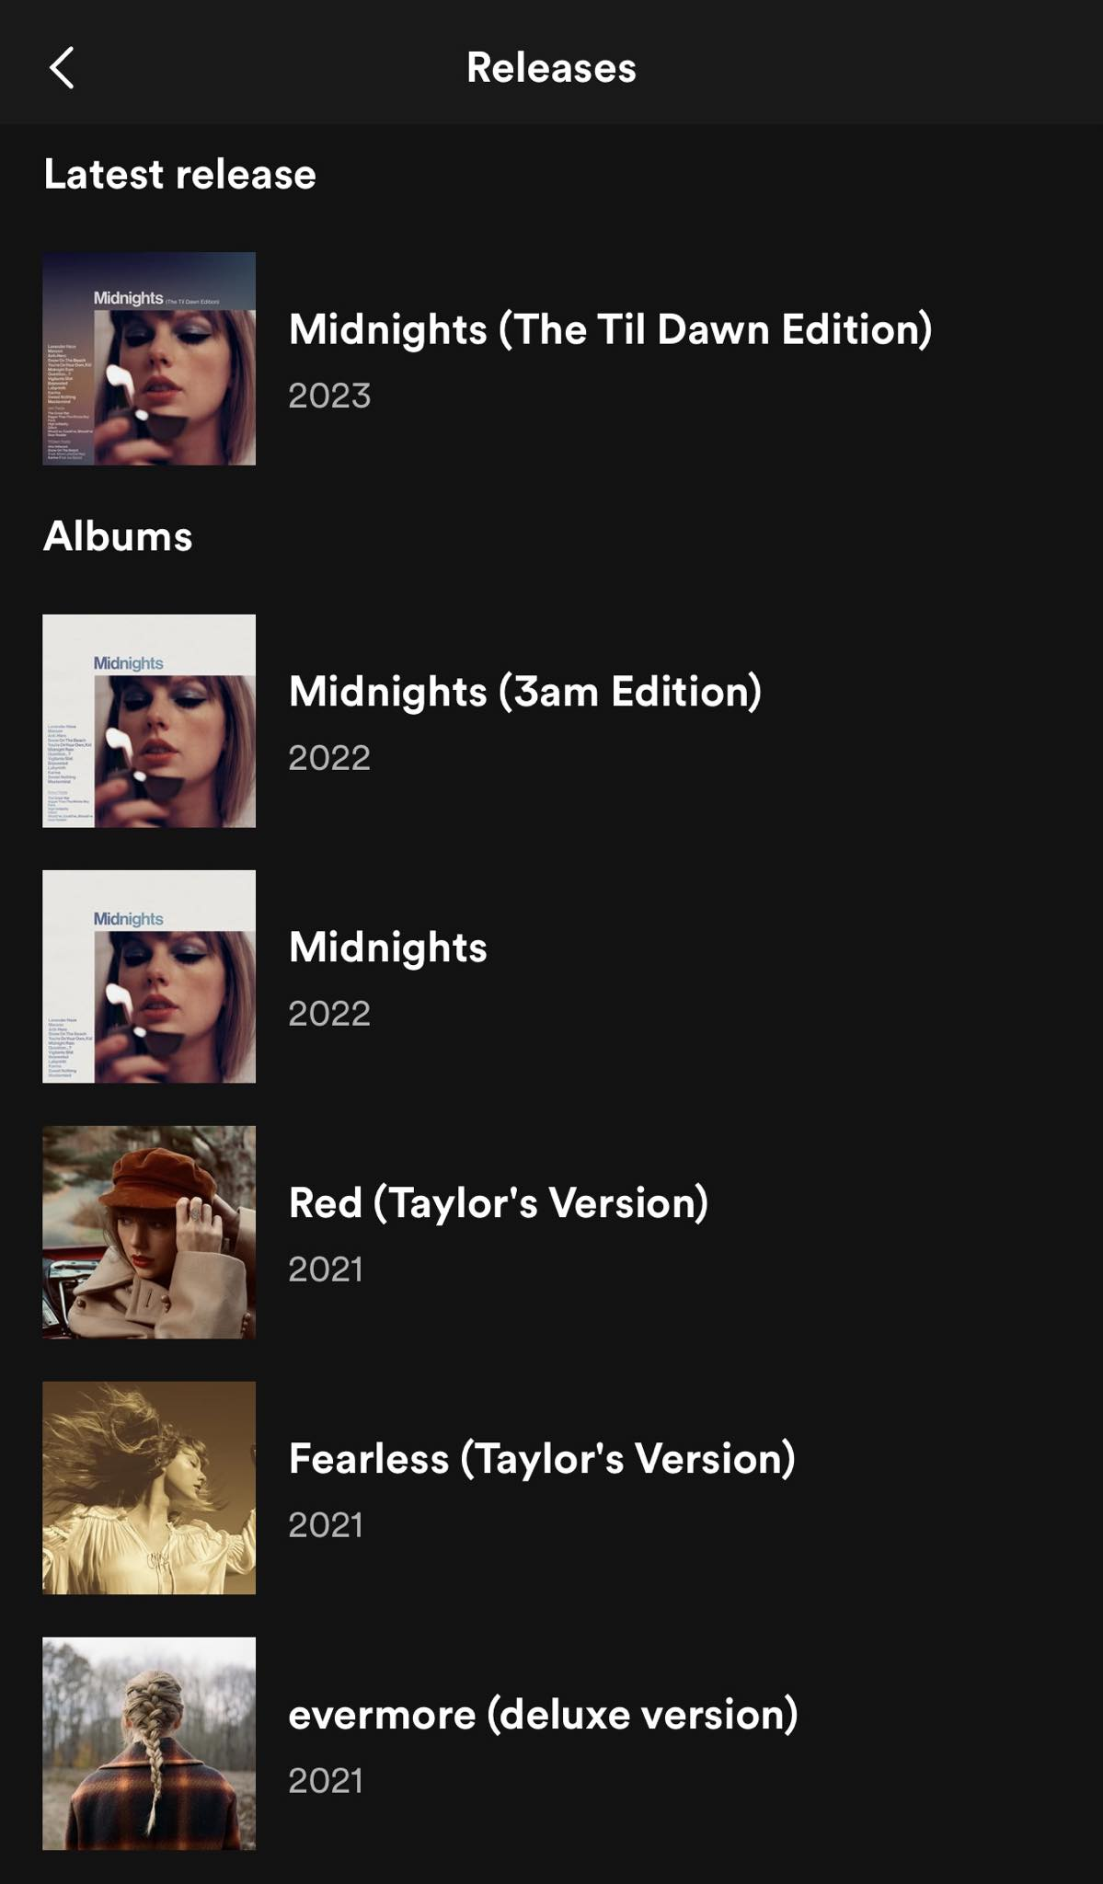
Glushko’s Foundations for Organizing Systems
01
Spotify’s Organization
What is being organized?
Music
Podcasts
Metadata!
Why is it being organized?
How much is it being organized and by whom?
When is it being organized?
Where is it being organized?

Slide 3
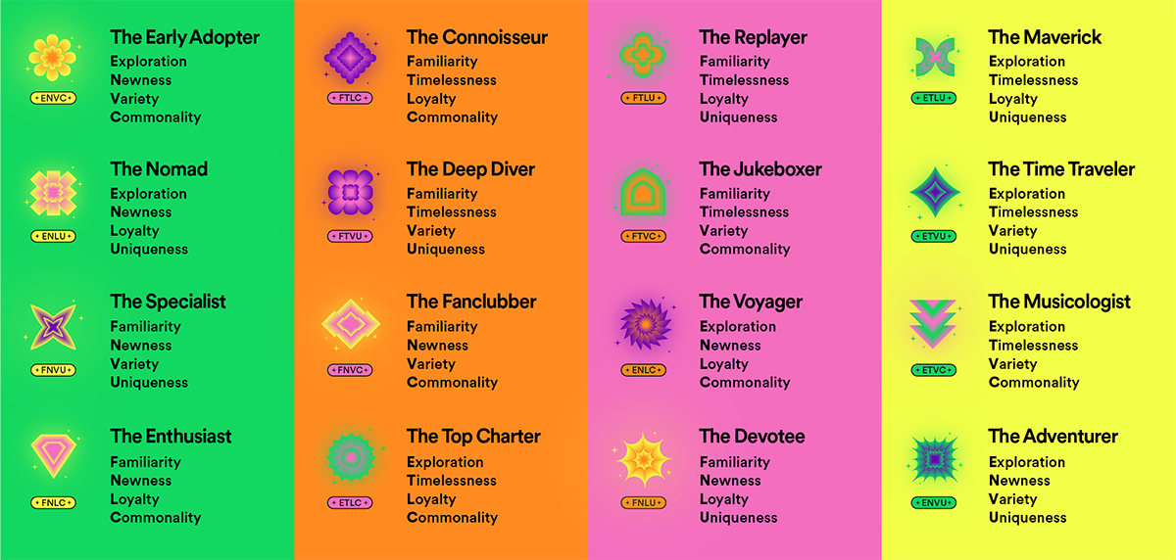
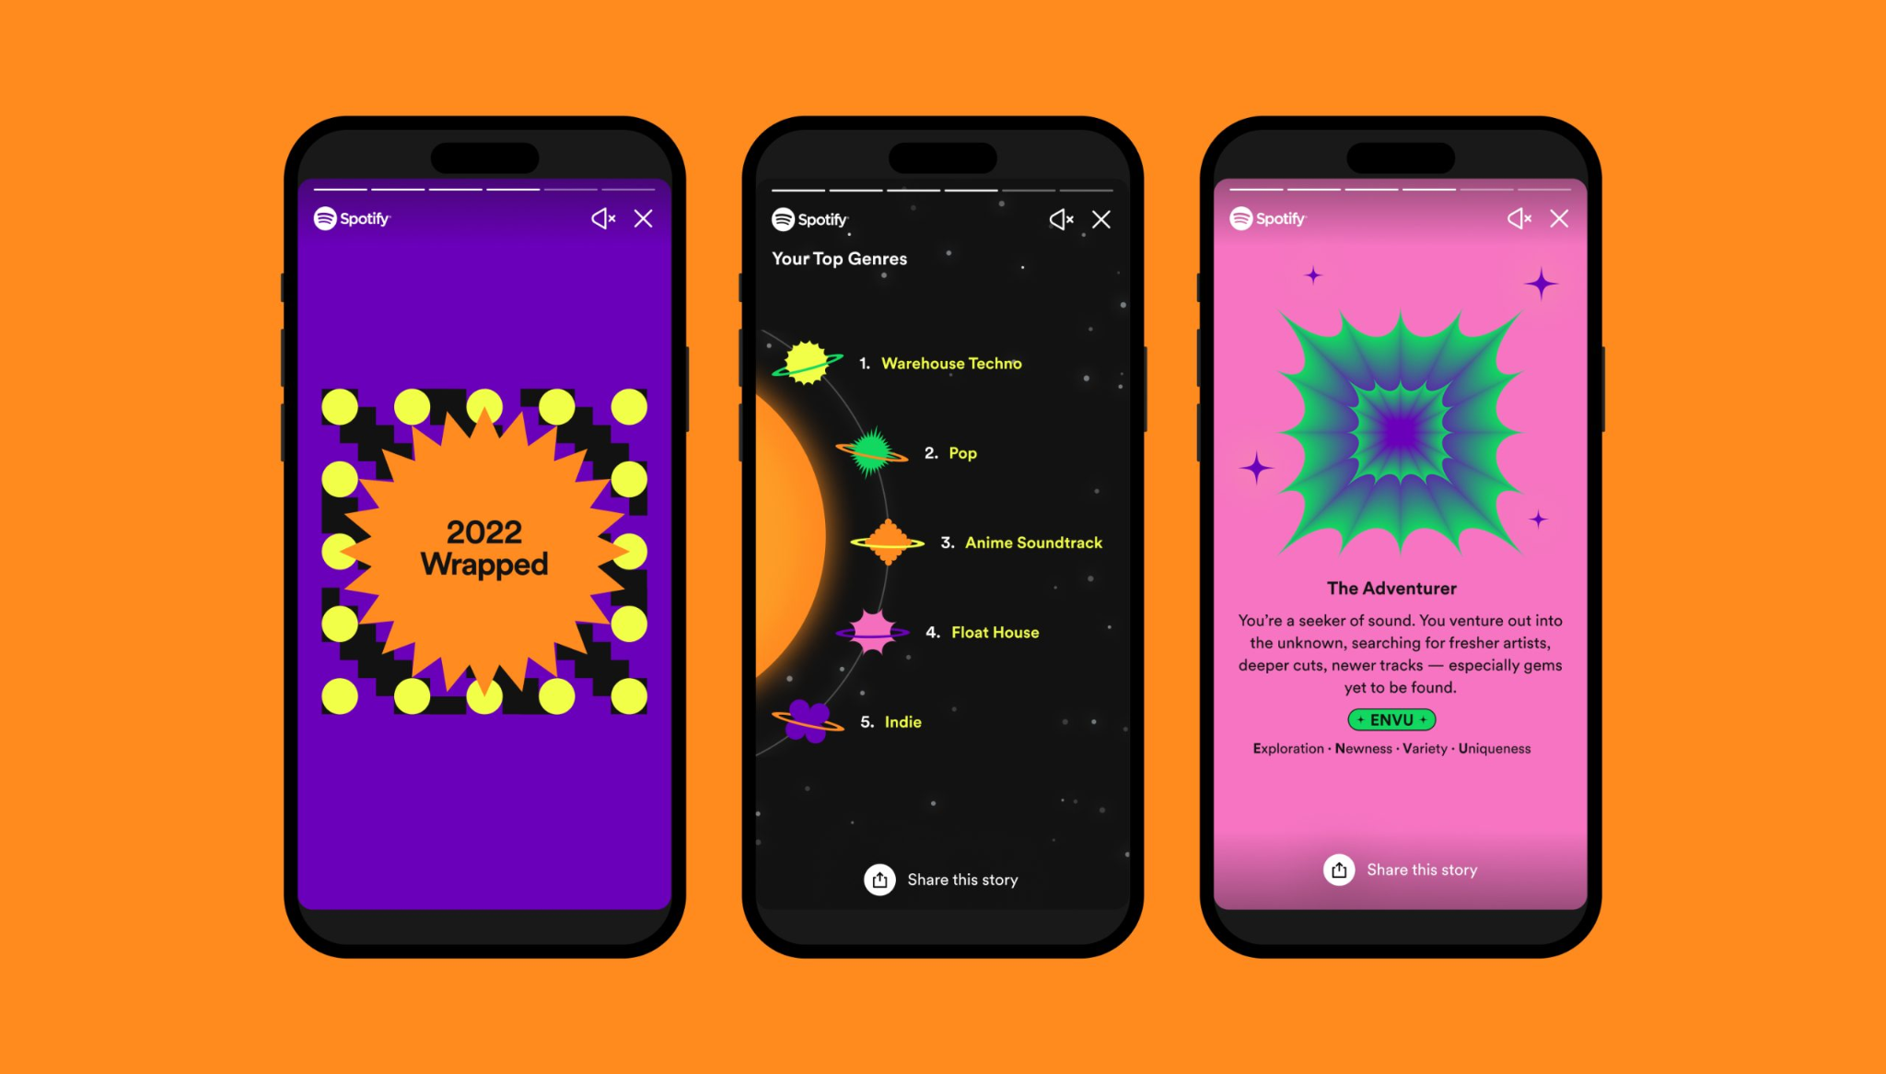
Spotify Wrapped (aka LOTS of Metadata!)
2
Spotify’s Metadata Wrap
Spotify releases a “Spotify Wrapped” at the end of each year.
It includes the following:
Your top artists
Your top songs
Your top genres
Your top podcasts
Your rankings as a top fan or top listener for an artist
The amount of time you’ve spent listening to music on Spotify
The number of artists you’ve discovered that year
2022’s Spotify Wrapped also gave us two new categories in our wraps:
A “listening personality”
How our music listening changed throughout the day

Slide 4
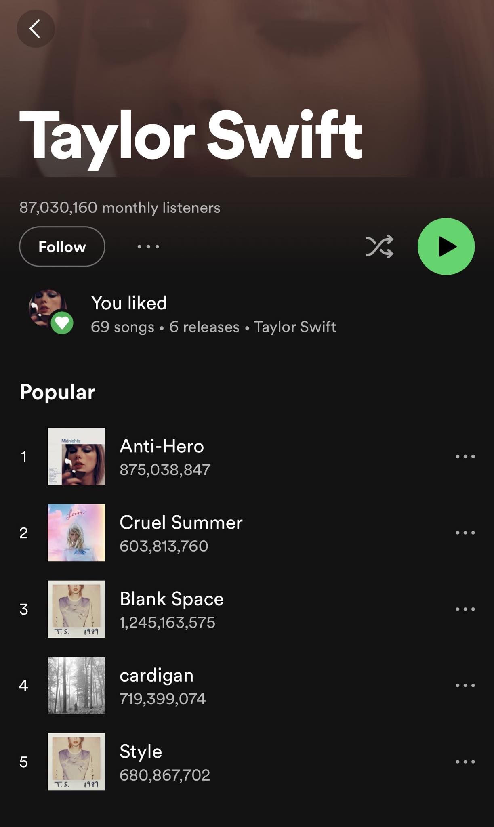
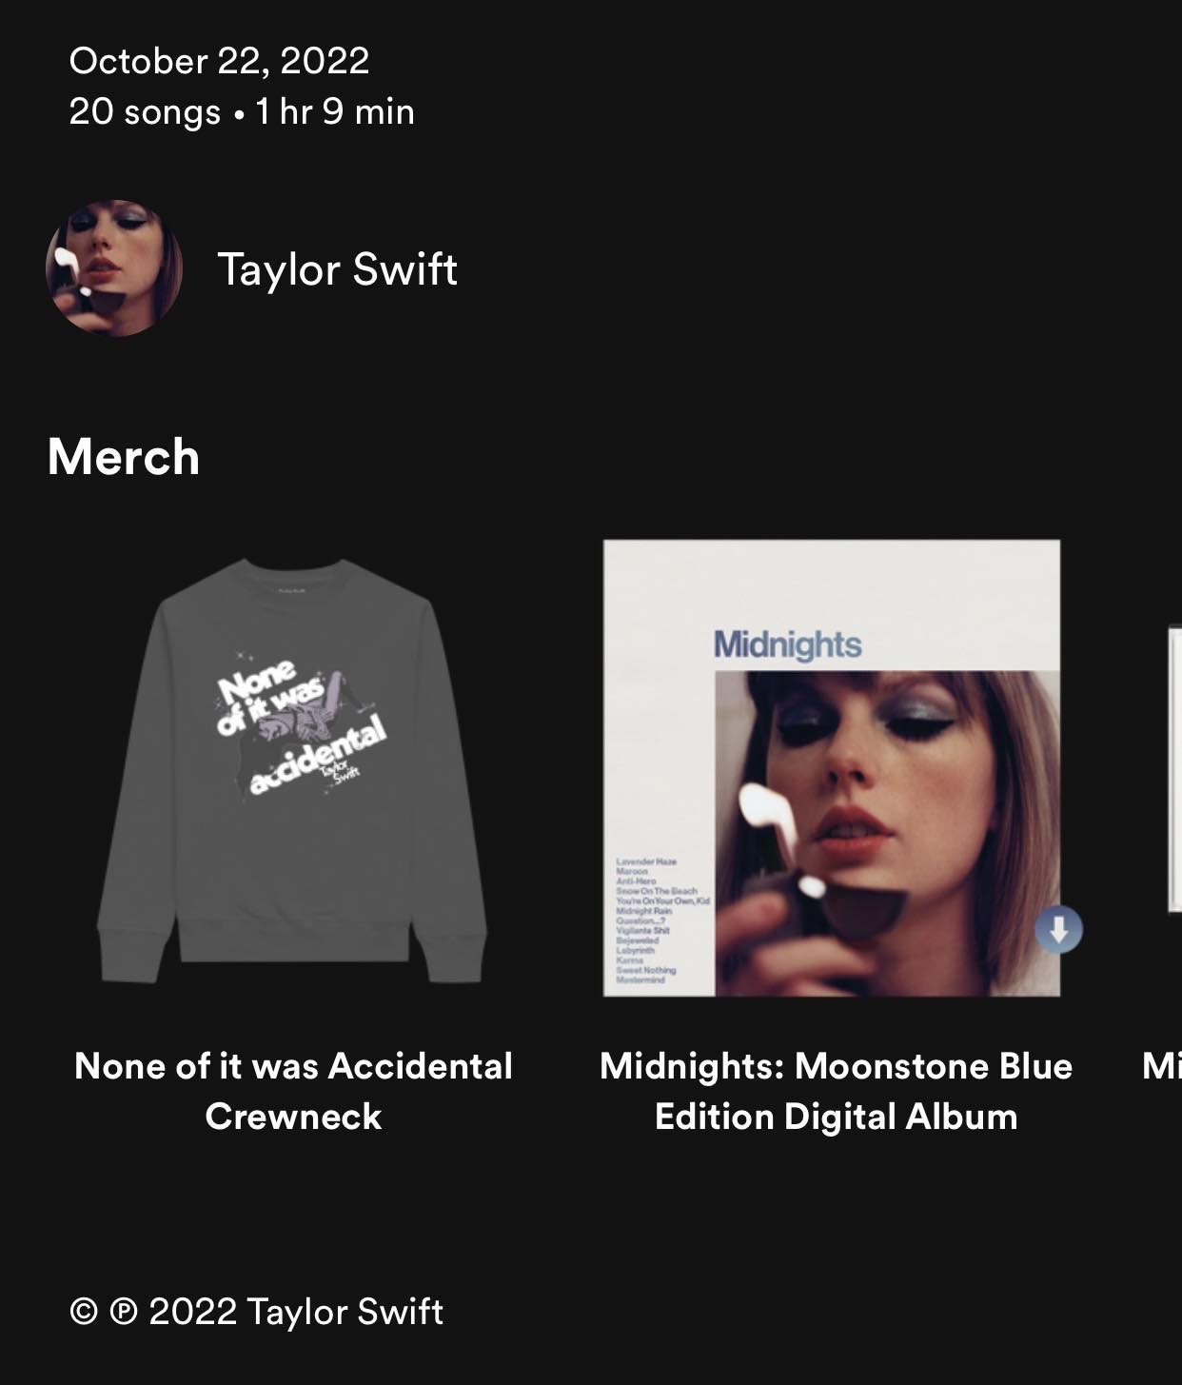
3
Types of Metadata
Album titles
Artists’ names
Lyrics
Genres
Release dates
Humming/singing
Riley’s Understanding Metadata provides a chapter on Metadata Types.
Metadata Type
Descriptive metadata
Technical metadata
Preservation metadata
Rights metadata
Structural metadata
Markup languages
File type
Sharing scheme
Discography
Popular Songs
Popular Releases
Copyright status
Rights holder

Slide 5
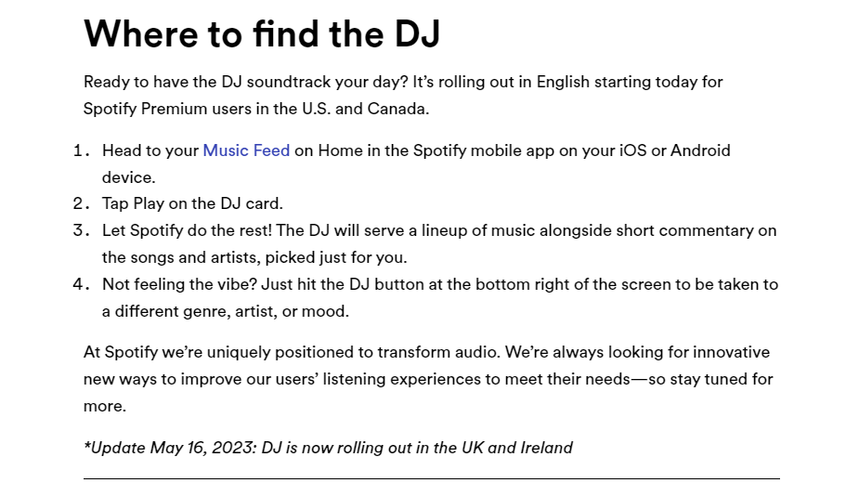
Spotify’s AI DJ
4
Spotify’s AI DJ
In February 2023, Spotify released an AI DJ to the US and Canada
As of May 2023, the UK and Ireland also have access to the AI DJ
According to Spotify’s website, “The DJ knows you and your music taste so well that it will scan the latest releases we know you’ll like, or take you back to that nostalgic playlist you had on repeat last year. Never before has listening felt so completely personal to each and every user”
The AI sorts through the latest music as well as the music you frequently listen to; then it reviews and curates playlists it thinks you would enjoy.
Based on your feedback, it refreshes the lineup.
Notes:
https://newsroom.spotify.com/2023-02-22/spotify-debuts-a-new-ai-dj-right-in-your-pocket/

